Slide 1
Day 23
Linux Device Driver Training
Kernel and Device Driver
Presented by,
Ganavi M
Ganavigowda512@gmail.com

Slide 2
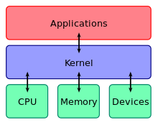
KERNEL
The kernel is the core component of an operating system that provides essential services such as process management, memory management, file system management, and device management.
It acts as an intermediary between applications and hardware, abstracting hardware complexities and providing a unified interface for software to interact with hardware resources.
Kernels can be monolithic, microkernel, or hybrid in design, with each design having its own advantages and trade-offs in terms of performance, modularity, and complexity.
Common kernel implementations include Linux kernel, Windows NT kernel, macOS kernel (XNU), and FreeBSD kernel.

Slide 3
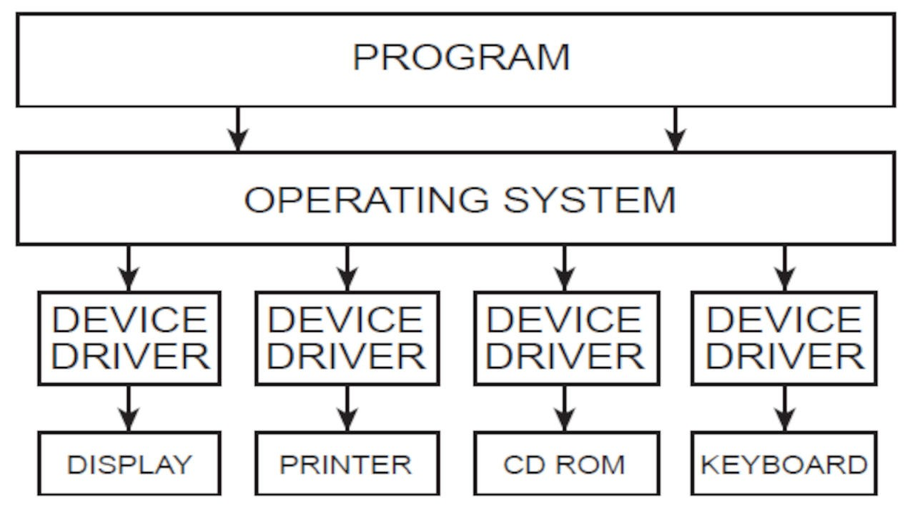
DEVICE DRIVERS
Device drivers are software components that enable the operating system to communicate with hardware devices such as disk drives, network adapters, graphics cards, and input/output devices.
They provide a standardized interface for the operating system to access and control hardware devices, abstracting hardware-specific details and providing a uniform programming interface.
Device drivers are typically implemented as kernel modules or dynamically linked libraries that can be loaded into the kernel at runtime.
Writing device drivers requires knowledge of hardware specifications, device communication protocols, and operating system internals. Device drivers are often written in C or C++.
Device drivers are essential for supporting new hardware devices, improving device performance, and fixing bugs or compatibility issues.

Slide 4

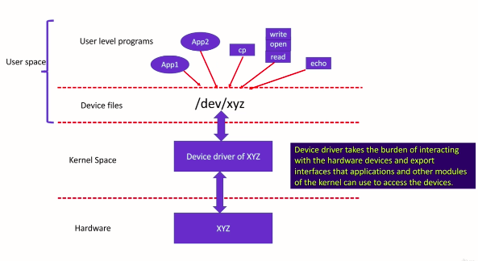

Slide 5
INTERACTION
The kernel manages device drivers and coordinates their interaction with hardware devices.
Device drivers communicate with the kernel through well-defined interfaces and system calls provided by the operating system's kernel API.
Device drivers may register themselves with the kernel during initialization, allowing the kernel to discover and manage available hardware devices.
Applications can indirectly access hardware devices through the kernel by invoking system calls or using higher-level APIs provided by the operating system.
SECURITY AND STABILITY​
​
Device drivers play a critical role in system security and stability. Poorly written or faulty device drivers can lead to system crashes, security vulnerabilities, or performance degradation.​
Kernel-mode device drivers have direct access to system resources and can potentially compromise system integrity if not properly designed, tested, and verified.​
Operating system vendors and hardware manufacturers collaborate to develop and maintain stable, secure, and efficient device drivers through rigorous testing, certification programs, and driver updates.​

Slide 6
ROLE OF DEVICE DRIVERS
1.Hardware Interaction:
Device drivers provide a standardized interface for the operating system to interact with hardware devices. They abstract the complexities of hardware communication, enabling software applications to access and control hardware devices using a uniform set of commands and protocols.
Device drivers handle low-level tasks such as sending commands to hardware, reading from and writing to device registers, and managing device interrupts.
2.Device Discovery and Initialization:
During system boot-up, device drivers are responsible for detecting and initializing hardware devices connected to the system. This process involves identifying the hardware type, configuring device settings, and allocating system resources (such as memory addresses and interrupt lines) for device operation.
Device drivers may use techniques such as probing, enumeration, and auto-configuration to detect and configure hardware devices dynamically.
3.Resource Management:
Device drivers manage system resources required for device operation, such as memory buffers, I/O ports, interrupt vectors, and DMA channels. They allocate and deallocate resources as needed, ensuring efficient utilization and preventing resource conflicts among multiple devices.
Resource management by device drivers is crucial for optimizing system performance, minimizing resource contention, and maintaining system stability.

Slide 7
4. Error Handling and Recovery:
i Device drivers handle errors and exceptions encountered during device operation, such as hardware faults, communication errors, and device malfunctions. They implement error detection mechanisms, error reporting facilities, and recovery procedures to mitigate the impact of hardware failures on system operation.
Device drivers may implement error-handling strategies such as retrying failed operations, resetting the device, logging error messages, and notifying the operating system or user about critical errors.
5. Power Management:
Modern device drivers incorporate power management features to optimize energy consumption and extend battery life in mobile devices and laptops. They implement power-saving techniques such as device idle states, dynamic frequency scaling, and device power gating to reduce power consumption during periods of inactivity.
Device drivers collaborate with the operating system's power management subsystem to coordinate device power transitions, ensuring that devices enter low-power modes when idle and resume normal operation when needed.
6. Security and Access Control:
Device drivers enforce security policies and access control mechanisms to protect sensitive hardware resources from unauthorized access and misuse. They implement authentication, authorization, and privilege management features to restrict access to privileged device operations and prevent unauthorized device access by untrusted software components.
Device drivers may integrate with the operating system's security framework to enforce security policies and enforce access control rules at the kernel level, ensuring that only authorized applications and users can access and manipulate hardware devices.

Slide 8
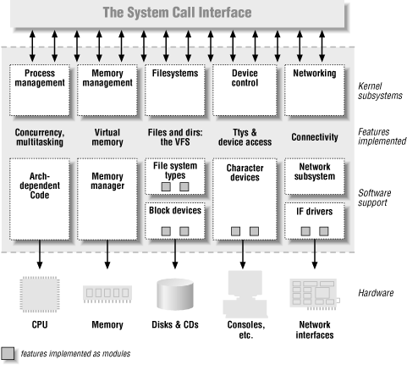
SPLITTING THE KERNEL
In a Unix system, several concurrent processes attend to different tasks. Each process asks for system resources, be it computing power, memory, network connectivity, or some other resource. The kernel is the big chunk of executable code in charge of handling all such requests. Though the distinction between the different kernel tasks isn’t always clearly marked, the kernel’s role can be spliT into the following parts

Slide 9
Process management
The kernel is in charge of creating and destroying processes and handling their connection to the outside world (input and output). Communication among different processes (through signals, pipes, or interprocess communication primitives) is basic to the overall system functionality and is also handled by the kernel. In addition, the scheduler, which controls how processes share the CPU, is part of process management. More generally, the kernel’s process management activity implements the abstraction of several processes on top of a single CPU or a few of them.
Memory management
The computer’s memory is a major resource, and the policy used to deal with it is a critical one for system performance. The kernel builds up a virtual addressing space for any and all processes on top of the limited available resources. The different parts of the kernel interact with the memory-management subsystem through a set of function calls, ranging from the simple malloc/free pair to much more exotic functionalities.
Filesystems
Unix is heavily based on the filesystem concept; almost everything in Unix can be treated as a file. The kernel builds a structured filesystem on top of unstructured hardware, and the resulting file abstraction is heavily used throughout the whole system. In addition, Linux supports multiple filesystem types, that is, different ways of organizing data on the physical medium. For example, diskettes may be formatted with either the Linux-standard ext2 filesystem or with the commonly used FAT filesystem.

Slide 10
Device control
Almost every system operation eventually maps to a physical device. With the exception of the processor, memory, and a very few other entities, any and all device control operations are performed by code that is specific to the device being addressed. That code is called a device driver. The kernel must have embedded in it a device driver for every peripheral present on a system, from the hard drive to the keyboard and the tape streamer. This aspect of the kernel’s functions is our primary interest in this book.
Networking
Networking must be managed by the operating system because most network operations are not specific to a process: incoming packets are asynchronous events. The packets must be collected, identified, and dispatched before a process takes care of them. The system is in charge of delivering data packets across program and network interfaces, and it must control the execution of programs according to their network activity. Additionally, all the routing and address resolution issues are implemented within the kernel.

Slide 11
DYNAMICALLY LOADABLE MODULES
Dynamically loadable modules (also known as loadable kernel modules or LKMs) are software components that can be loaded into the kernel at runtime to extend its functionality or add support for new hardware devices. Here's an overview of dynamically loadable modules:
Purpose:
Dynamically loadable modules allow kernel functionality to be added, removed, or updated without the need to recompile or reboot the entire kernel.
They provide a flexible and efficient mechanism for extending the kernel's capabilities, supporting new hardware, and implementing additional features such as filesystems, network protocols, and device drivers.
Implementation:
Loadable kernel modules are typically implemented as shared object files (e.g., .ko files on Linux) containing compiled kernel code.
These modules can be dynamically loaded into the kernel using utilities such as insmod or modprobe, which handle the insertion and initialization of the module.
Once loaded, a module becomes part of the kernel's address space and can interact with other kernel components through defined interfaces and APIs.

Slide 12
C Features:
Loadable kernel modules can provide various types of functionality, including device drivers, filesystems, network protocols, security modules, and virtualization components.
They can be written in languages such as C or assembly language and may access kernel data structures and functions to perform their tasks.
Modules can export symbols (functions, variables) that can be used by other kernel modules or user-space applications.
D Dynamic Loading and Unloading:
Modules can be dynamically loaded into the kernel using utilities like insmod or modprobe. The kernel searches for the module file, verifies its compatibility, and loads it into memory.
Once loaded, the module's initialization function is called to perform any required setup or initialization tasks.
Modules can be dynamically unloaded from the kernel using utilities like rmmod. Before unloading, the module's cleanup function is called to release resources and perform any necessary cleanup tasks.
Dynamically loading and unloading modules allows the kernel to adapt to changing hardware configurations, system requirements, and user preferences without the need for system downtime.

Slide 13
UTILITIES IN LINUX DRIVERS
insmod:
insmod stands for "insert module" and is a basic command-line utility for inserting LKMs into the Linux kernel.
When you run insmod followed by the path to the module file, it directly inserts the specified module into the kernel without performing dependency resolution.
insmod does not handle module dependencies automatically. If the module being inserted depends on other modules, you need to ensure that those dependencies are already loaded into the kernel or manually load them beforehand.
This utility is useful for inserting modules when you have explicit knowledge of the module's dependencies and want to insert them directly.
Using insmod:
If you want to use insmod to insert the module, you would execute the following command:
sudo insmod /path/to/my_module.ko
This command directly inserts my_module.ko into the kernel without performing dependency resolution. If my_module.ko depends on other modules, you would need to ensure that those dependencies are already loaded into the kernel.

Slide 14
2. modprobe:
modprobe is a more advanced command-line utility that handles the insertion and management of kernel modules, including dependency resolution.
When you run modprobe followed by the name of the module (without the file path), it searches the module dependencies and loads them recursively before loading the specified module.
modprobe reads module dependency information from the /lib/modules/<kernel_version>/modules.dep file or other specified module dependency files. It automatically resolves dependencies and loads them as needed.
Additionally, modprobe provides options for handling module options, blacklisting modules, and configuring module aliases.
modprobe is the preferred utility for most cases because it simplifies the process of module loading by automatically handling dependencies.
Using modprobe:
If you prefer to use modprobe to insert the module, you would execute the following command:
sudo modprobe my_module
modprobe automatically resolves dependencies by reading module dependency information from /lib/modules/<kernel_version>/modules.dep or other specified dependency files. It loads the dependencies recursively before loading my_module.

Slide 15
COMMON CLASSES OF DEVICES AND MODULES
Character Devices:
Character devices are devices that transfer data to and from the user one character at a time, without buffering the data. Examples include keyboards, mice, serial ports, and character-based terminals.
Character device drivers handle I/O operations on these devices, providing functions for reading from and writing to the device one character at a time.
Block Devices:
Block devices are devices that transfer data to and from the user in fixed-size blocks or chunks, typically of several kilobytes in size. Examples include hard disk drives (HDDs), solid-state drives (SSDs), and USB storage devices.
Block device drivers manage I/O operations on these devices, providing functions for reading and writing data in blocks, as well as handling disk caching, buffering, and disk scheduling.
Network Devices:
Network devices are devices that provide network connectivity and communication capabilities, such as Ethernet adapters, Wi-Fi adapters, and network interface cards (NICs).
Network device drivers manage communication with these devices, handling tasks such as packet transmission and reception, MAC address filtering, and network protocol processing (e.g., TCP/IP stack).

Slide 16
4. Filesystem Modules:
Filesystem modules provide support for different filesystem types, allowing the operating system to read from and write to storage devices formatted with those filesystems. Examples include ext4, NTFS, FAT, and Btrfs filesystems.
Filesystem modules implement filesystem-specific data structures, algorithms, and operations for managing files, directories, and metadata on storage devices.
5. Miscellaneous Devices:
Miscellaneous devices encompass a wide range of devices that do not fit neatly into the character, block, or network device categories. Examples include random number generators, hardware watchdog timers, real-time clocks (RTCs), and input/output control (ioctl) devices.
Miscellaneous device drivers handle I/O operations on these devices, providing device-specific functionality and interfaces for accessing device features and capabilities.
6. Loadable Kernel Modules (LKMs):
Loadable kernel modules are software components that can be dynamically loaded into the kernel at runtime to extend its functionality or add support for new hardware devices.
LKMs can belong to any of the above device classes and provide device drivers or kernel functionality in the form of loadable modules.

Slide 17
BOOTING COMPONENTS
The booting process of a computer system involves several components working together to initialize hardware, load the operating system into memory, and prepare the system for user interaction. Here are the key components involved in the booting process:
Basic Input/Output System (BIOS):
The BIOS is firmware stored on a chip on the motherboard of a computer. It provides low-level hardware initialization routines and acts as an interface between the hardware components and the operating system.
During the boot process, the BIOS performs a power-on self-test (POST) to check the integrity of hardware components such as the CPU, memory, storage devices, and input/output devices.
After the POST completes successfully, the BIOS searches for a bootable device, typically the primary storage device (e.g., hard disk drive or solid-state drive), by reading the Master Boot Record (MBR) or the GUID Partition Table (GPT).
Bootloader:
The bootloader is a small program stored in the boot sector of a storage device that is executed after the BIOS completes its initialization process.
The bootloader's primary function is to load the operating system kernel into memory and transfer control to it. It may also provide options for selecting different operating systems or boot configurations.
Common bootloaders include GRUB (GRand Unified Bootloader) and LILO (LInux LOader) for Linux-based systems, as well as NTLDR (NT Loader) and Bootmgr for Windows-based systems.

Slide 18
3. Kernel Initialization:
Once control is transferred to the operating system kernel by the bootloader, the kernel initialization process begins.
The kernel initializes essential hardware components, such as the CPU, memory, interrupt controllers, and device drivers required for basic system operation.
The kernel sets up data structures, initializes kernel data structures such as process tables and page tables, and configures system parameters based on hardware and configuration settings.
4. Init Process:
After the kernel initialization completes, the init process, or its successor (such as systemd in modern Linux distributions), is launched as the first user-space process.
The init process is responsible for initializing the user-space environment, starting system services, and launching user sessions.
The init process reads its configuration files (e.g., /etc/inittab or systemd unit files) to determine which system services to start and in what order.
5. User Space Initialization:
Once the init process starts, it initializes the user-space environment by mounting filesystems, setting up network interfaces, and initializing system services.
System services include daemons responsible for tasks such as managing system time, handling user authentication, managing hardware devices, and providing network services.
Once user space is fully initialized, the system is ready for user interaction, and the login prompt or graphical user interface (GUI) is presented to the user.

Slide 19
init Process:
The init process, traditionally the first user-space process spawned by the Linux kernel during boot, has the process ID (PID) of 1. It is responsible for initializing the system after the kernel has completed its boot process.
The primary role of the init process is to bring the system to a fully operational state by starting and managing system services, daemons, and user sessions.
init reads its configuration file, such as /etc/inittab or systemd unit files, to determine which system services to start, the order in which they should be started, and their dependencies.
In modern Linux distributions, such as those using systemd as the init system, the role of init is often performed by systemd, which serves as a more sophisticated and flexible init system.
Kernel Modules:
Kernel modules, also known as loadable kernel modules (LKMs), are pieces of code that can be dynamically loaded into the Linux kernel at runtime to extend its functionality or provide support for additional hardware devices, filesystems, and features.
Kernel modules are typically stored as files with a .ko extension and contain code and data that can be inserted into or removed from the running kernel as needed.
The role of kernel modules is to provide support for hardware devices (such as network adapters, storage controllers, and graphics cards) that are not directly supported by the kernel or to add additional features and functionality to the kernel.
Kernel modules can be loaded manually using utilities like insmod or modprobe, or automatically by the system during boot based on hardware detection or configuration files.

Slide 20
HELLO WORLD PROGRAM
#INCLUDE <LINUX/INIT.H>
#INCLUDE <LINUX/MODULE.H>
MODULE_LICENSE(“DUAL BSD/GPL”);
STATIC INT __INIT HELLO_INIT(VOID) {
PRINTK(KERN_ALERT “HELLO, WORLD\N”);
RETURN 0;
}
STATIC VOID __EXIT HELLO_EXIT(VOID) {
PRINTK(KERN_ALERT “GOODBYE, CRUEL WORLD\N”);
}
MODULE_INIT(HELLO_INIT);
MODULE_EXIT(HELLO_EXIT);

Slide 21
Preliminaries
In the context of kernel development, preliminaries refer to the initial setup and configuration required before the kernel can start executing its main functionality.
This includes tasks such as hardware detection and initialization, memory setup, setting up interrupt handling, initializing data structures, and preparing the kernel environment.
Preliminaries ensure that the kernel is in a consistent and usable state before it begins executing higher-level code.
Initialization and Shutdown
Initialization refers to the process of preparing the kernel and its components for operation. This includes setting up data structures, initializing subsystems, and starting essential services.
During initialization, the kernel initializes various subsystems such as process management, memory management, filesystems, networking, and device drivers.
Shutdown, on the other hand, is the process of gracefully stopping the kernel and shutting down the system. This involves stopping running processes, releasing resources, and syncing filesystems.
Proper initialization and shutdown are crucial for ensuring system stability, data integrity, and consistent behavior.

Slide 22
CLEANUP FUNCTION
In the context of kernel programming, the cleanup function refers to a function used to perform cleanup tasks when a kernel module is unloaded or removed from memory.
When a kernel module is no longer needed or is being replaced by a newer version, the kernel calls its cleanup function to release any resources allocated by the module and perform any necessary cleanup actions.
The cleanup function typically deallocates memory, releases hardware resources, unregisters device drivers, and performs other cleanup tasks to ensure that the system returns to a consistent state after the module is unloaded.
Proper cleanup is essential for preventing memory leaks, resource leaks, and other forms of resource contention or corruption in the kernel.
MAKEFILE
Makefile is a script that specifies how to compile and build a program or project. It contains a set of rules that define how source files should be compiled and linked to produce executable binaries

Slide 23
^{LINKING AND UNLINKING MODULES}
A user can link a module into the running kernel by executing the insmod external program. This program performs the following operations:
Reads from the command line the name of the module to be linked.
Locates the file containing the module’s object code in the system directory tree. The file is usually placed in some subdirectory below /lib/modules.
Reads from disk the file containing the module’s object code.
Invokes the init_module( ) system call, passing to it the address of the User Mode buffer containing the module’s object code, the length of the object code, and the User Mode memory area containing the parameters of the insmod program.
Terminates.
The sys_init_module( ) service routine does all the real work; it performs the following main operations:
Checks whether the user is allowed to link the module (the current process must have the CAP_SYS_MODULE capability). In every situation where one is adding functionality to a kernel, which has access to all data and processes on the system, security is a paramount concern.
Allocates a temporary memory area for the module’s object code; then, copies into this memory area the data in the User Mode buffer passed as first parameter of the system call.
Checks that the data in the memory area effectively represents a module’s ELF object; otherwise, returns an error code.
Allocates a memory area for the parameters passed to the insmod program, and fills it with the data in the User Mode buffer whose address ...

Slide 24
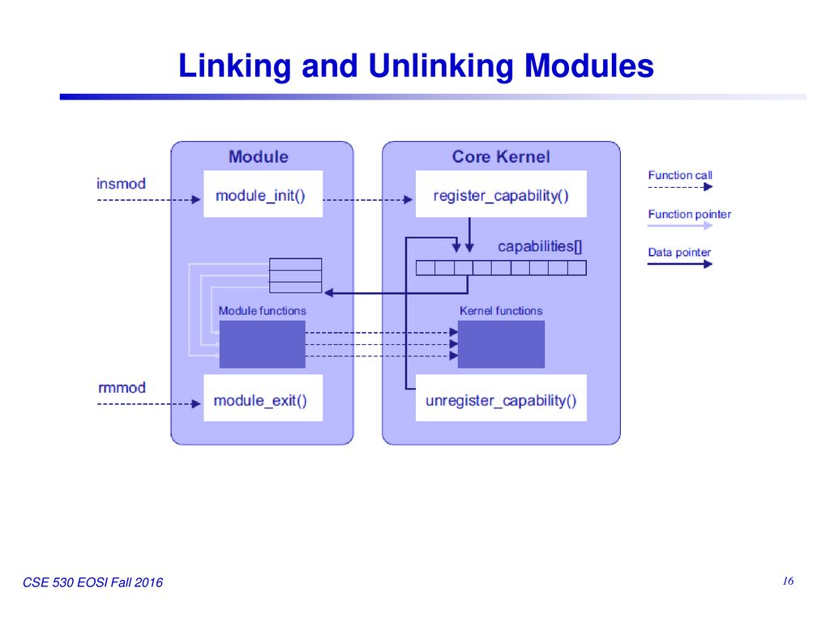

Slide 25
KERNEL MODULES V/s APPLICATIONS​
Purpose:
Kernel Module: Kernel modules (or loadable kernel modules) extend the functionality of the operating system kernel. They provide low-level access to hardware devices, filesystems, network protocols, and other kernel services. Kernel modules run in kernel space and have direct access to hardware resources.
Application: Applications are user-space programs that run on top of the operating system. They provide higher-level functionality such as user interfaces, data processing, networking, and system utilities. Applications interact with the kernel and other system resources through system calls and libraries.
Execution Environment:
Kernel Module: Kernel modules run within the kernel space of the operating system. They are loaded into memory by the kernel and execute as part of the kernel's address space. Kernel modules have privileged access to hardware and system resources.
Application: Applications run in user space, separate from the kernel. They execute within their own process(es) and memory space. Applications do not have direct access to hardware resources and must interact with the kernel through system calls and other interfaces.

Slide 26
3. Access to System Resources:
Kernel Module: Kernel modules have direct access to system resources, including hardware devices, memory, and CPU. They can interact with hardware devices directly, manipulate kernel data structures, and modify system behavior.
Application: Applications have restricted access to system resources and must request access through the operating system. They interact with hardware devices and other system resources indirectly through system calls and libraries provided by the kernel.
4. Development and Deployment:
Kernel Module: Developing and deploying kernel modules requires knowledge of kernel internals, device drivers, and kernel programming techniques. Kernel modules are typically distributed as separate files (e.g., .ko files) and loaded into the kernel dynamically at runtime.
Application: Developing and deploying applications is more straightforward and does not require knowledge of kernel internals. Applications are typically distributed as executable binaries or source code and run on top of the operating system.
5. Privileges and Security:
Kernel Module: Kernel modules run with elevated privileges and have full access to system resources. Malfunctioning or malicious kernel modules can potentially crash the system or compromise system security.
Application: Applications run with limited privileges and are isolated from the kernel and other applications. They are subject to user permissions and access controls enforced by the operating system.

Slide 27
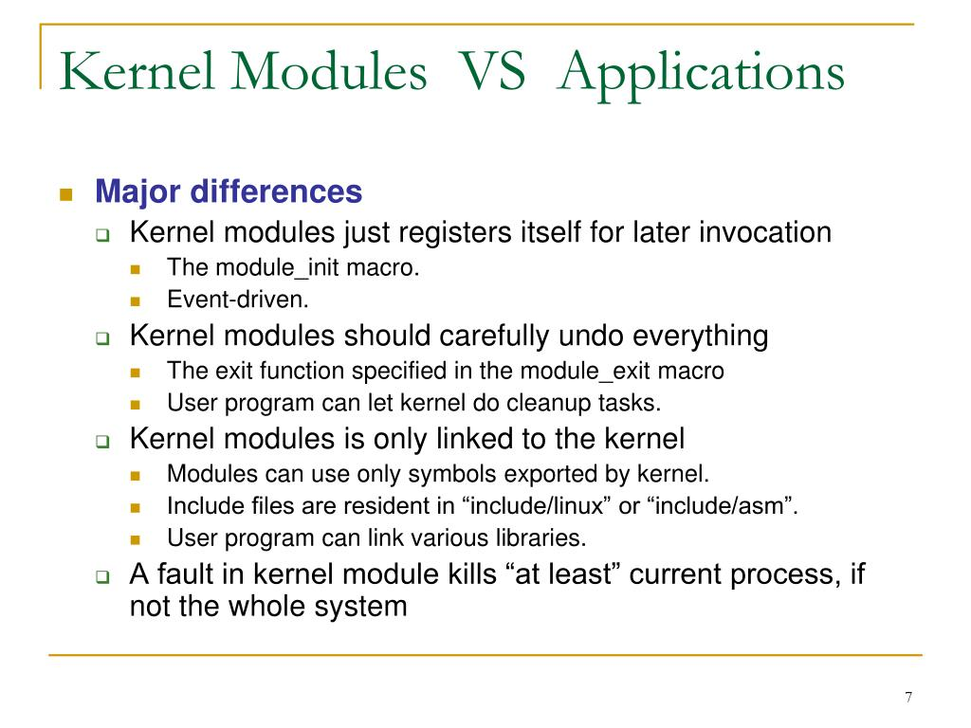

Slide 28
Thank you

